Slide 1
Assessing randomness in nanoparticles

Slide 2

Randomness in respect to size

Slide 3
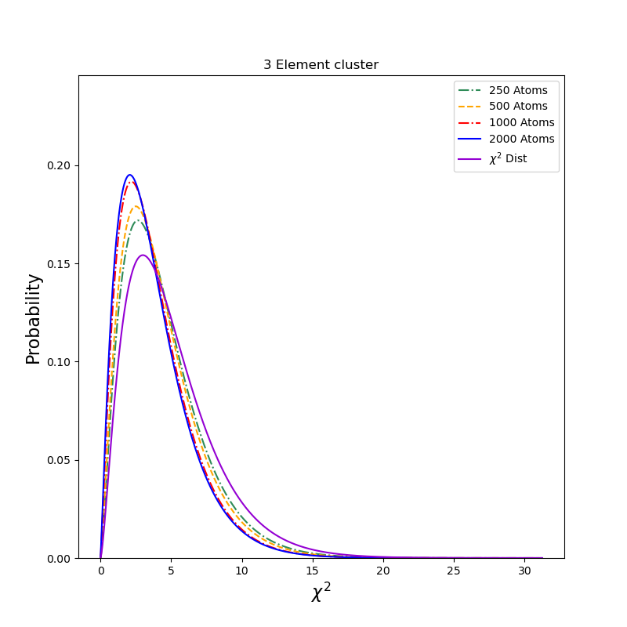
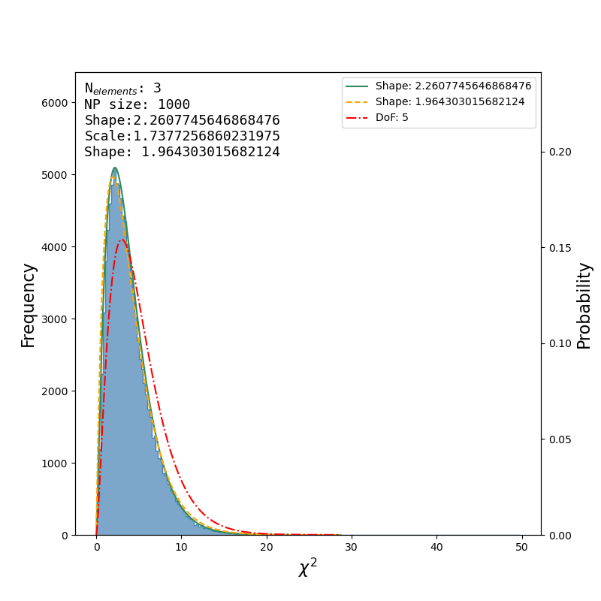
Gamma distribution of clusters

Slide 4
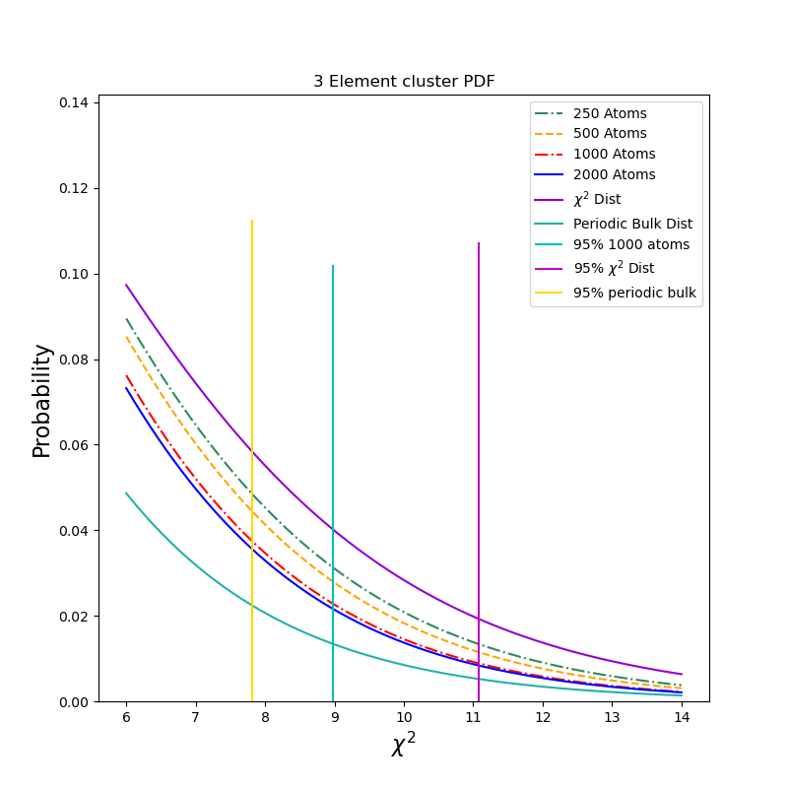
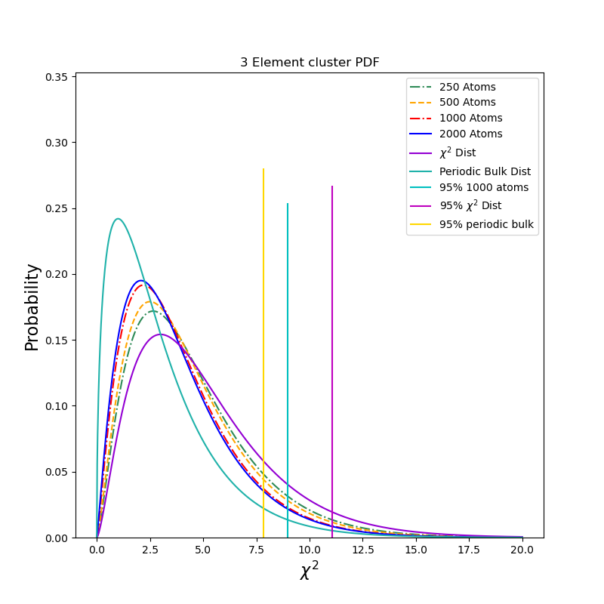
95th percentiles with bulk

Slide 5
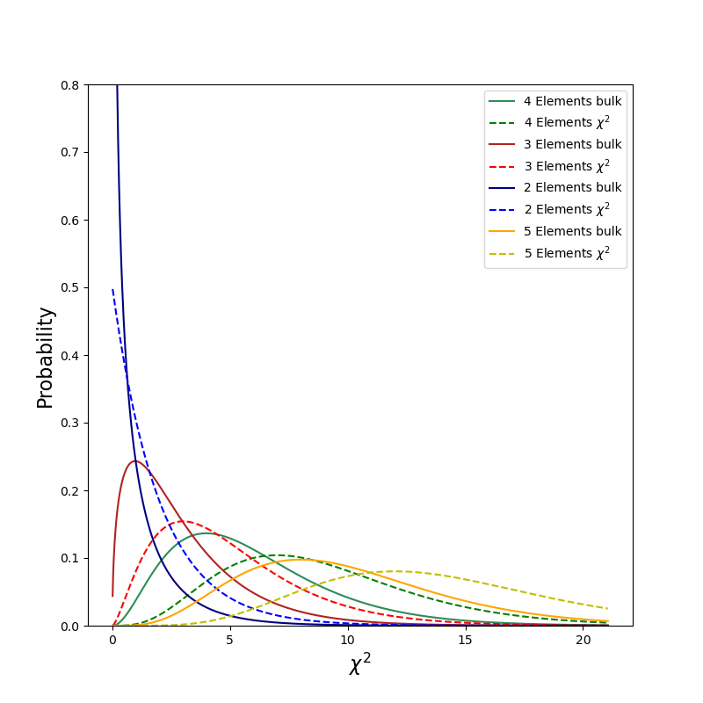

Bulk compared to Chi2 dist

Slide 6
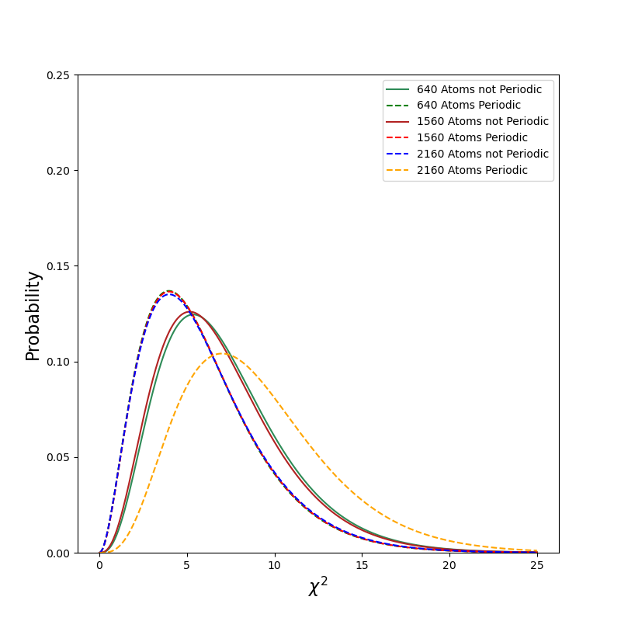

Slide 7
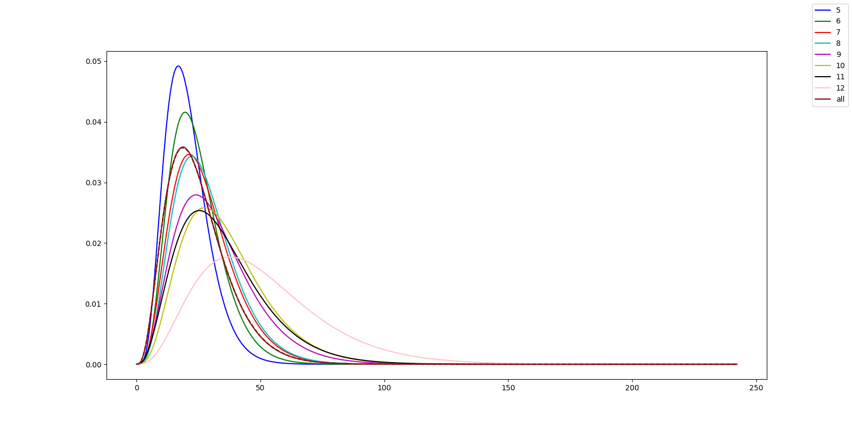

Gamma distribution of each coordination of a six element particle

Slide 8
